Slide 1
Group Homomorphism
by
Dr. T. M. Rajalaxmi
Assistant Professor
Department of Mathematics

Slide 2
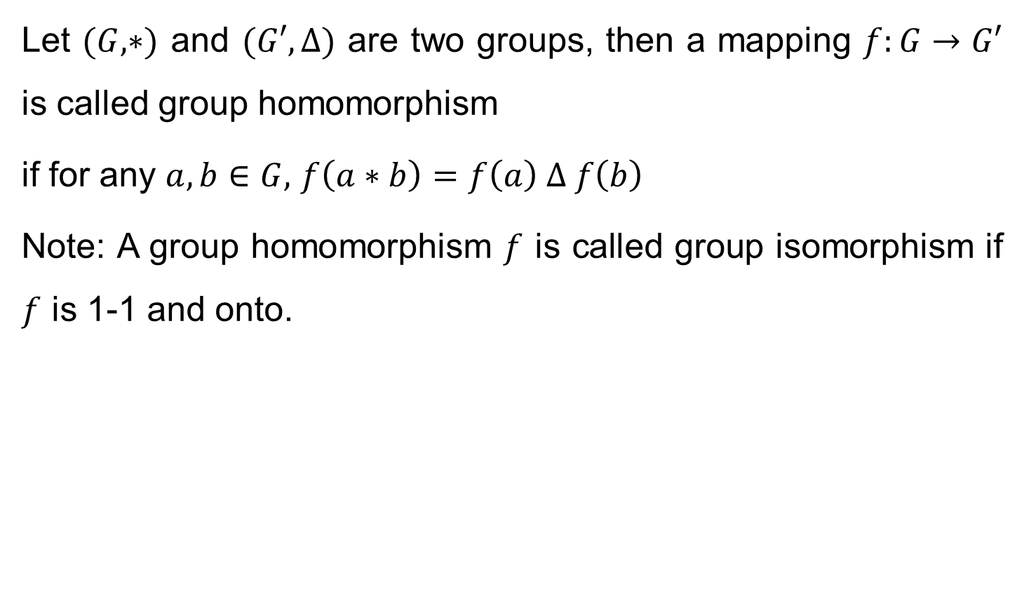
Definition
Let $(G,∗)$ and $(G′,∆)$ are two groups, then a mapping $f:G→G′$ is called group homomorphism
if for any $a,b∈G,$ $f\left(a∗b\right)=f\left(a\right) ∆ f\left(b\right)$
Note: A group homomorphism $f$ is called group isomorphism if $f$ is 1-1 and onto.

Slide 3
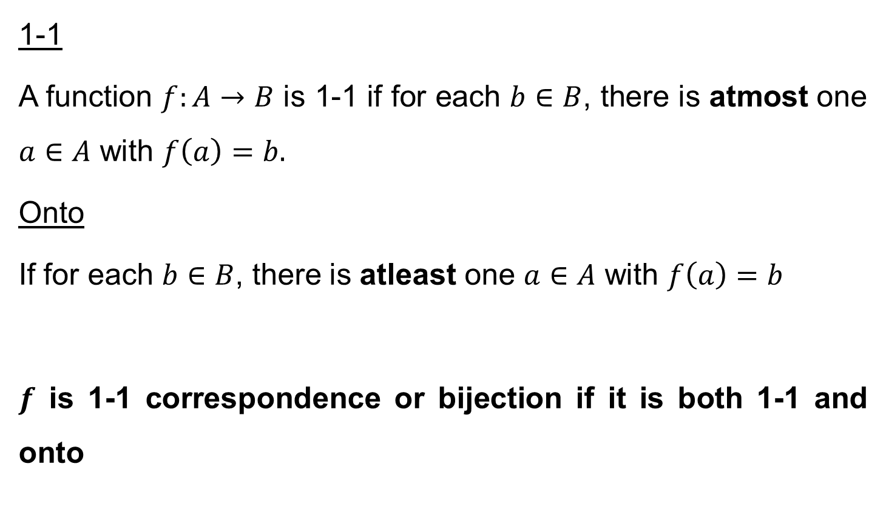
Remember
1-1
A function $f:A→B$ is 1-1 if for each $b∈B$, there is atmost one $a∈A$ with $f\left(a\right)=b.$
Onto
If for each $b∈B$, there is atleast one $a∈A$ with $f\left(a\right)=b$
$f$ is 1-1 correspondence or bijection if it is both 1-1 and onto

Slide 4
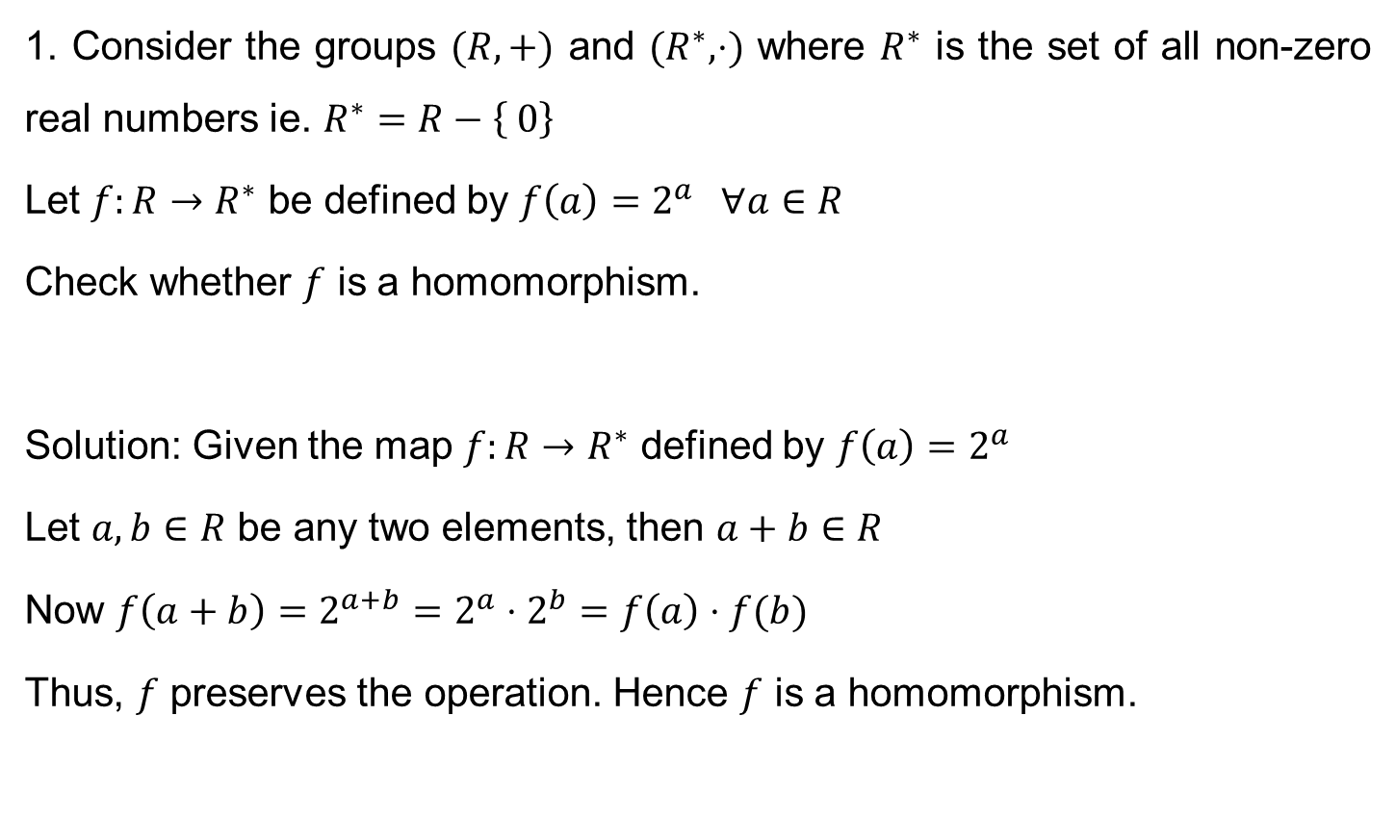
Problems
1. Consider the groups $(R,+)$ and $(R^{∗},⋅)$ where $R^{∗}$ is the set of all non-zero real numbers ie. $R^{∗}=R−\left\{ 0\right\}$
Let $f:R→R^{∗}$ be defined by $f\left(a\right)=2^{a} ∀a∈R$
Check whether $f$ is a homomorphism.
Solution: Given the map $f:R→R^{∗}$ defined by $f\left(a\right)=2^{a}$
Let $a,b∈R$ be any two elements, then $a+b∈R$
Now $f\left(a+b\right)=2^{a+b}=2^{a}⋅2^{b}=f\left(a\right)⋅f(b)$
Thus, $f$ preserves the operation. Hence $f$ is a homomorphism.

Slide 5
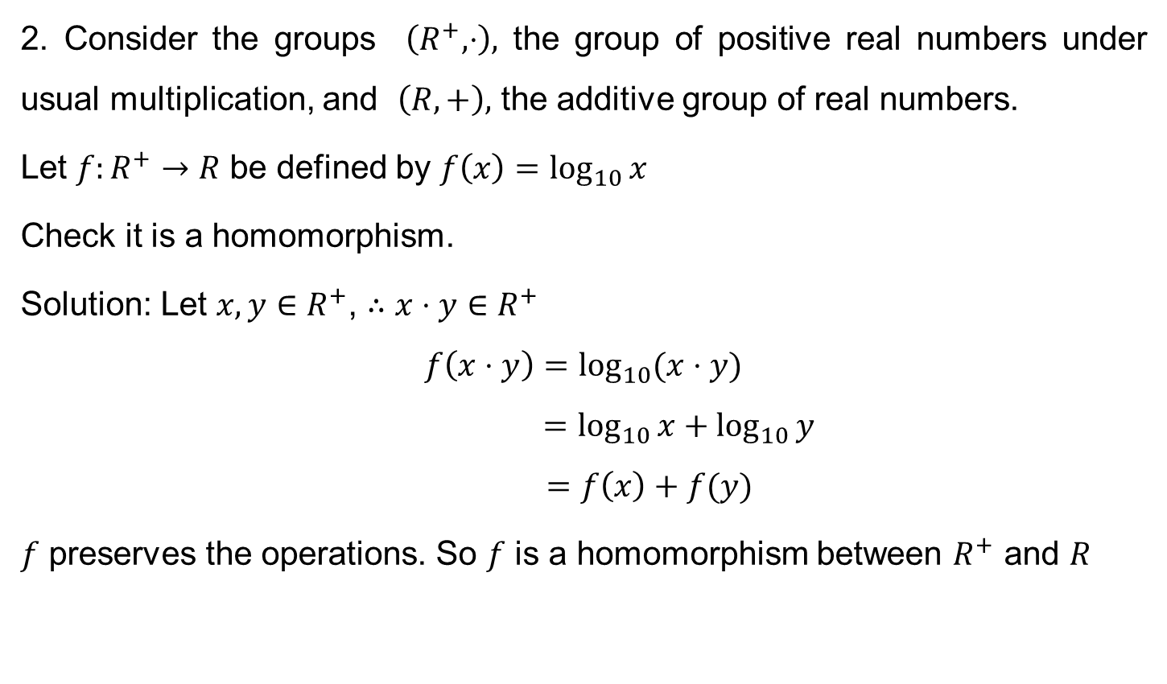
Problems
2. Consider the groups $\left(R^{+},⋅\right),$ the group of positive real numbers under usual multiplication, and $\left(R,+\right),$ the additive group of real numbers.
Let $f:R^{+}→R$ be defined by $f\left(x\right)=\log_{10}{x}$
Check it is a homomorphism.
Solution: Let $x,y∈R^{+}$, $∴x⋅y∈R^{+}$
$$f\left(x⋅y\right)=\log_{10}{(x⋅y)}$$
$$=\log_{10}{x}+\log_{10}{y}$$
$$=f\left(x\right)+f(y)$$
$f$ preserves the operations. So $f$ is a homomorphism between $R^{+}$ and $R$

Slide 6
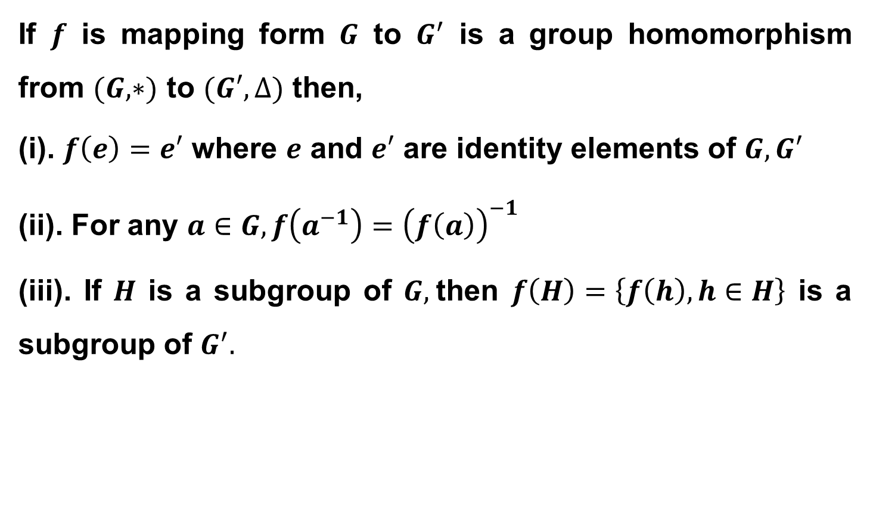
Theorem
If $f$ is mapping form $G$ to $G^{′}$ is a group homomorphism from $(G,∗)$ to $(G′,∆)$ then,
(i). $f\left(e\right)=e′$ where $e$ and $e′$ are identity elements of $G, G′$
(ii). For any $a∈G, f\left(a^{−1}\right)={\left(f\left(a\right)\right)}^{−1}$
(iii). If $H$ is a subgroup of $G,$then $f\left(H\right)=\left\{f\left(h\right),h∈H\right\}$ is a subgroup of $G^{′}.$

Slide 7
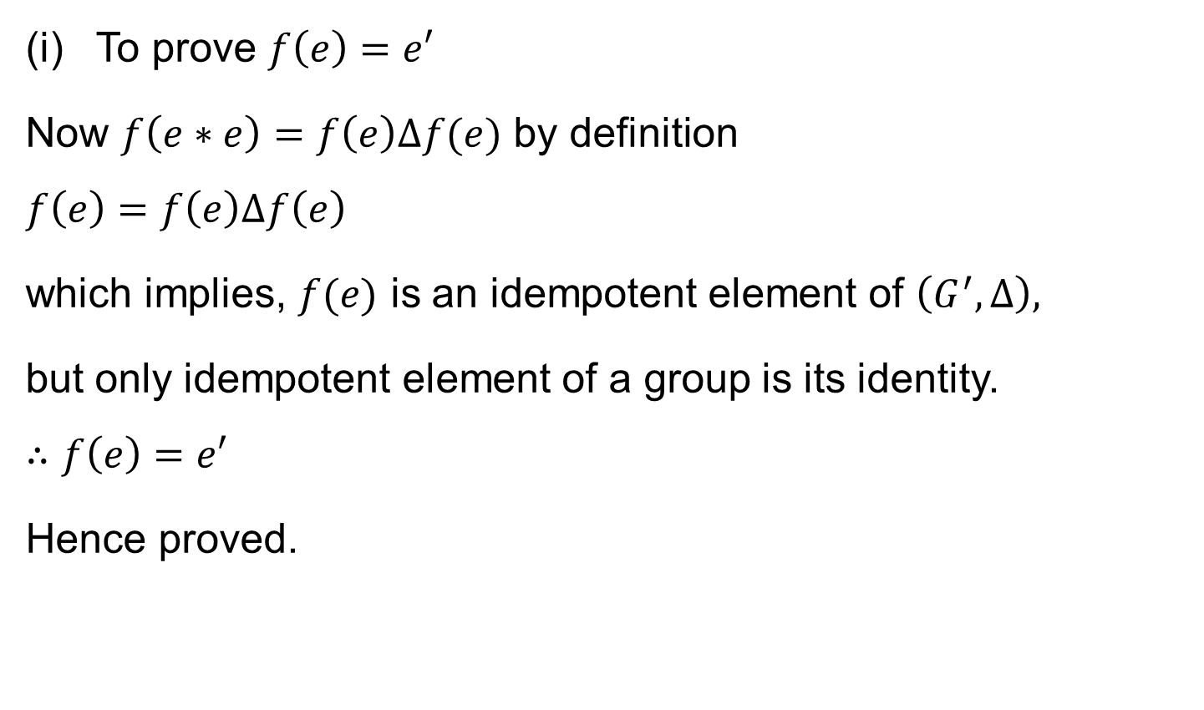
Theorem
To prove $f\left(e\right)=e′$
Now $f\left(e∗e\right)=f\left(e\right)∆f(e)$ by definition
$$f\left(e\right)=f\left(e\right)∆f\left(e\right)$$
which implies, $f(e)$ is an idempotent element of $\left(G^{′},∆\right),$
but only idempotent element of a group is its identity.
$$∴f\left(e\right)=e′$$
Hence proved.

Slide 8
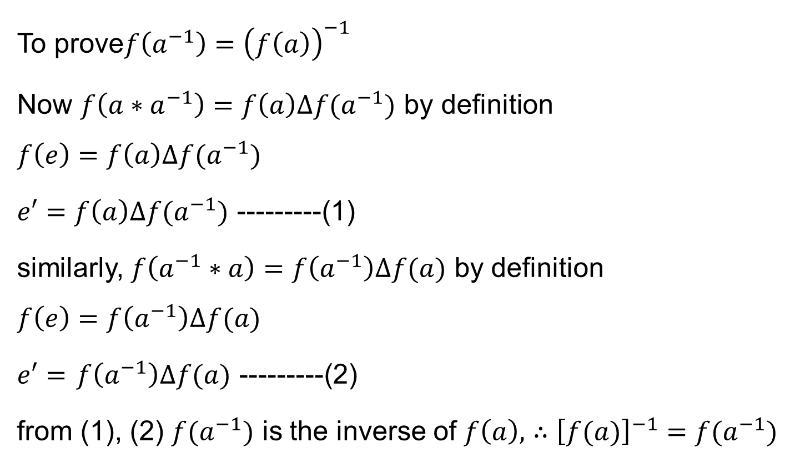
Theorem
To prove$f\left(a^{−1}\right)={\left(f\left(a\right)\right)}^{−1}$
Now $f\left(a∗a^{−1}\right)=f\left(a\right)∆f(a^{−1})$ by definition
$$f\left(e\right)=f\left(a\right)∆f(a^{−1})$$
$e′=f\left(a\right)∆f(a^{−1})$ ---------(1)
similarly, $f\left(a^{−1}∗a\right)=f\left(a^{−1}\right)∆f(a)$ by definition
$$f\left(e\right)=f\left(a^{−1}\right)∆f(a)$$
$e′=$ $f\left(a^{−1}\right)∆f(a)$ ---------(2)
from (1), (2) $f(a^{−1})$ is the inverse of $f\left(a\right),$ $∴{\left[f(a)\right]}^{−1}=f(a^{−1})$

Slide 9
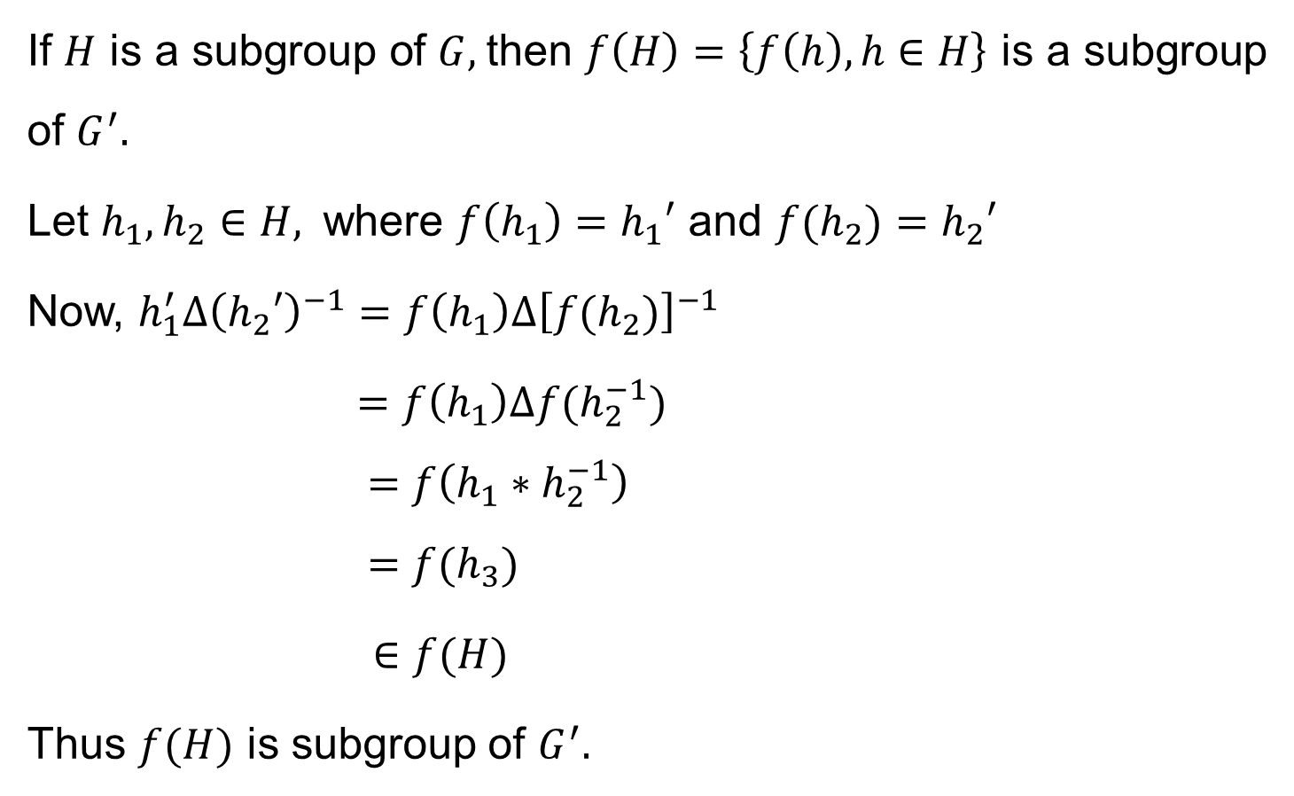
Theorem
If $H$ is a subgroup of $G,$then $f\left(H\right)=\left\{f\left(h\right),h∈H\right\}$ is a subgroup of $G^{′}.$
Let $h_{1},h_{2}∈H,$ where $f\left(h_{1}\right)=h_{1}′$ and $f(h_{2})=h_{2}′$
Now, $h_{1}^{′}∆{\left(h_{2}′\right)}^{−1}=f\left(h_{1}\right)∆{\left[f(h_{2})\right]}^{−1}$
$=f\left(h_{1}\right)∆f(h_{2}^{−1})$
$$=f\left(h_{1}∗h_{2}^{−1}\right)$$
$$=f(h_{3})$$
$∈f(H)$
Thus $f(H)$ is subgroup of $G^{′}.$

Slide 10
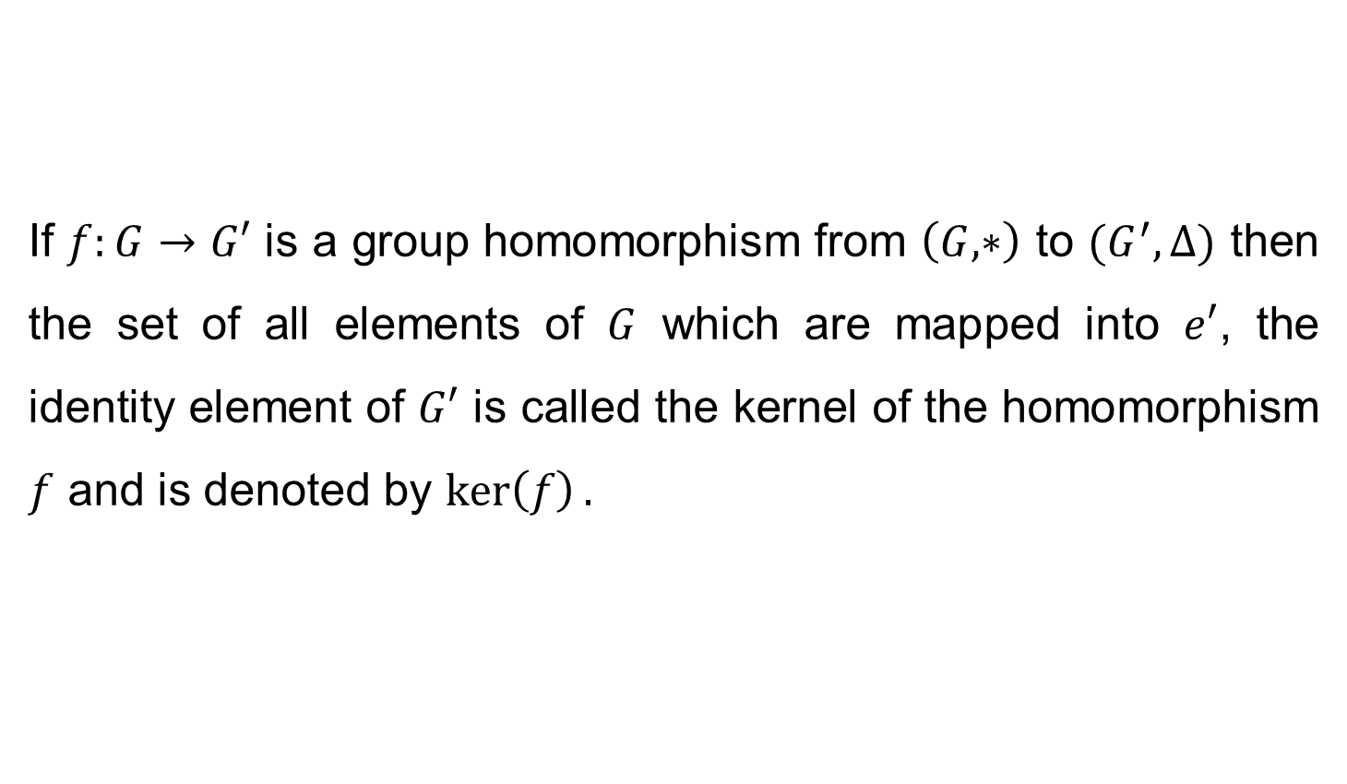
Kernel of a Homomorphism
If $f:G→G′$ is a group homomorphism from $\left(G,∗\right)$ to $(G^{′},∆)$ then the set of all elements of $G$ which are mapped into $e′$, the identity element of $G′$ is called the kernel of the homomorphism $f$ and is denoted by $\ker\left(f\right).$

Slide 11
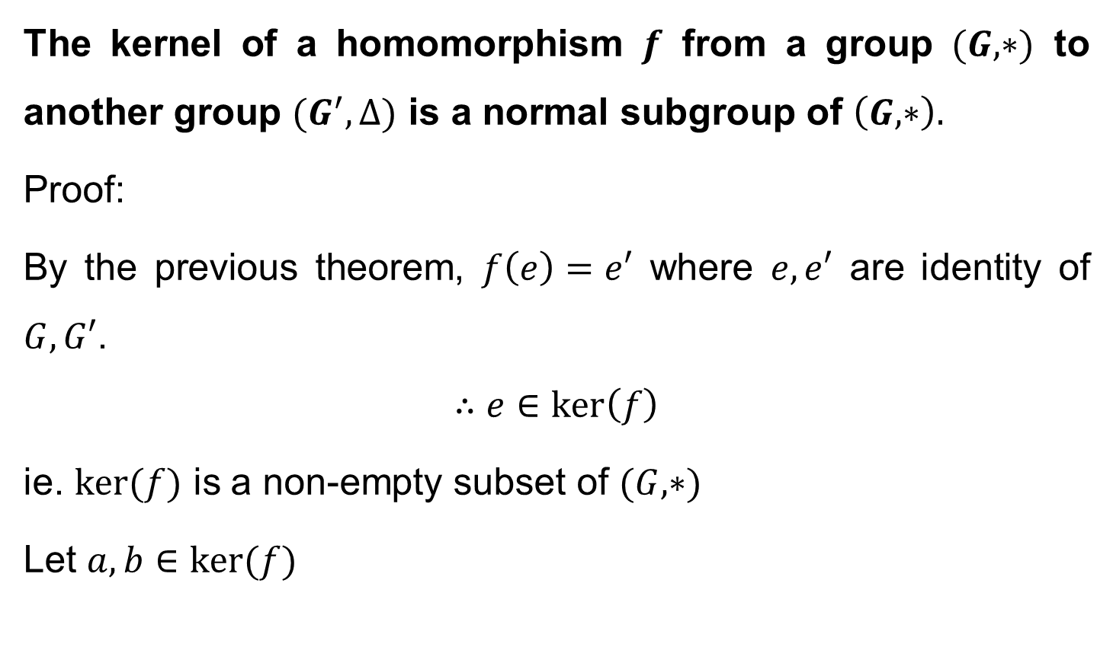
Theorem
The kernel of a homomorphism $f$ from a group $(G,∗)$ to another group $(G^{′},∆)$ is a normal subgroup of $\left(G,∗\right).$
Proof:
By the previous theorem, $f\left(e\right)=e′$ where $e, e′$ are identity of $G, G′$.
$$∴e∈\ker\left(f\right)$$
ie. $\ker{(f)}$ is a non-empty subset of $(G,∗)$
Let $a,b∈\ker{(f)}$

Slide 12
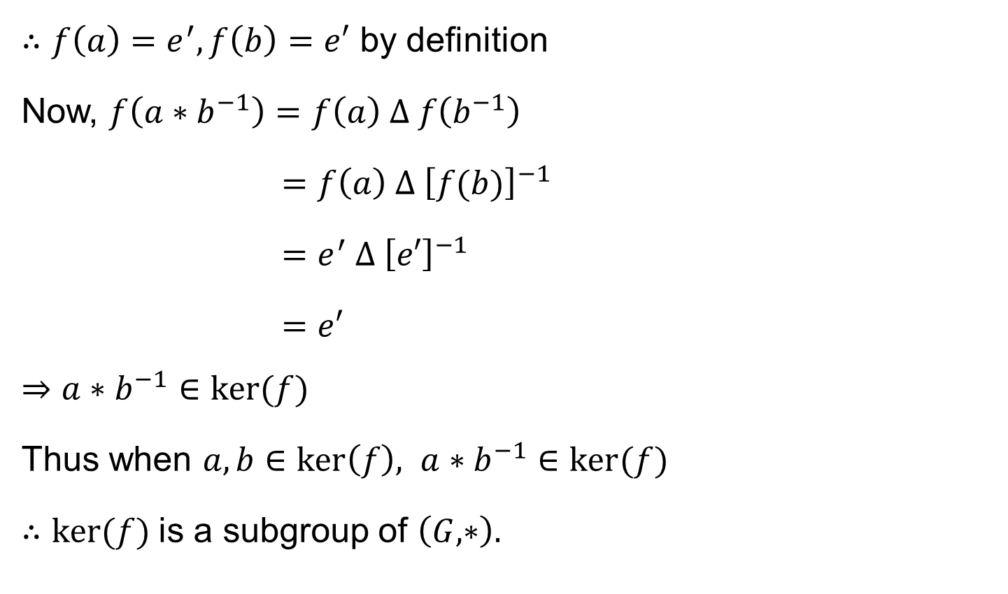
Theorem cont’d
$∴f\left(a\right)=e^{′}, f\left(b\right)=e′$ by definition
Now, $f\left(a∗b^{−1}\right)=f\left(a\right) ∆ f\left(b^{−1}\right)$
$=f\left(a\right) ∆ {\left[f(b)\right]}^{−1}$
$=e^{′} ∆ {\left[e′\right]}^{−1}$
$=e′$
$$⇒a∗b^{−1}∈\ker{(f)}$$
Thus when $a,b∈\ker\left(f\right), a∗b^{−1}∈\ker{(f)}$
$∴\ker{(f)}$is a subgroup of $\left(G,∗\right).$

Slide 13
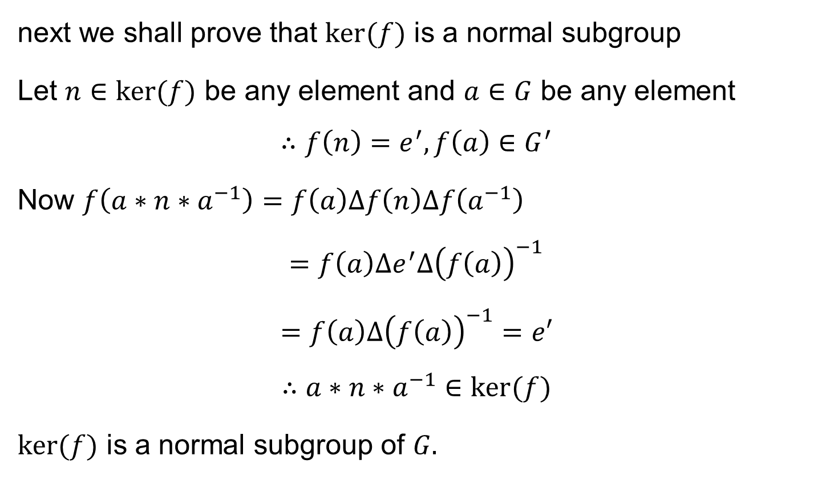
Theorem cont’d
next we shall prove that $\ker{(f})$ is a normal subgroup
Let $n∈\ker{(f})$ be any element and $a∈G$ be any element
$$∴f\left(n\right)=e^{′}, f\left(a\right)∈G^{′}$$
Now $f\left(a∗n∗a^{−1}\right)=f\left(a\right)∆f\left(n\right)∆f\left(a^{−1}\right)$
$$=f\left(a\right)∆e^{′}∆{\left(f\left(a\right)\right)}^{−1}$$
$$=f\left(a\right)∆{\left(f\left(a\right)\right)}^{−1}=e′$$
$$∴a∗n∗a^{−1}∈\ker{(f)}$$
$\ker{(f)}$ is a normal subgroup of $G.$

Slide 14
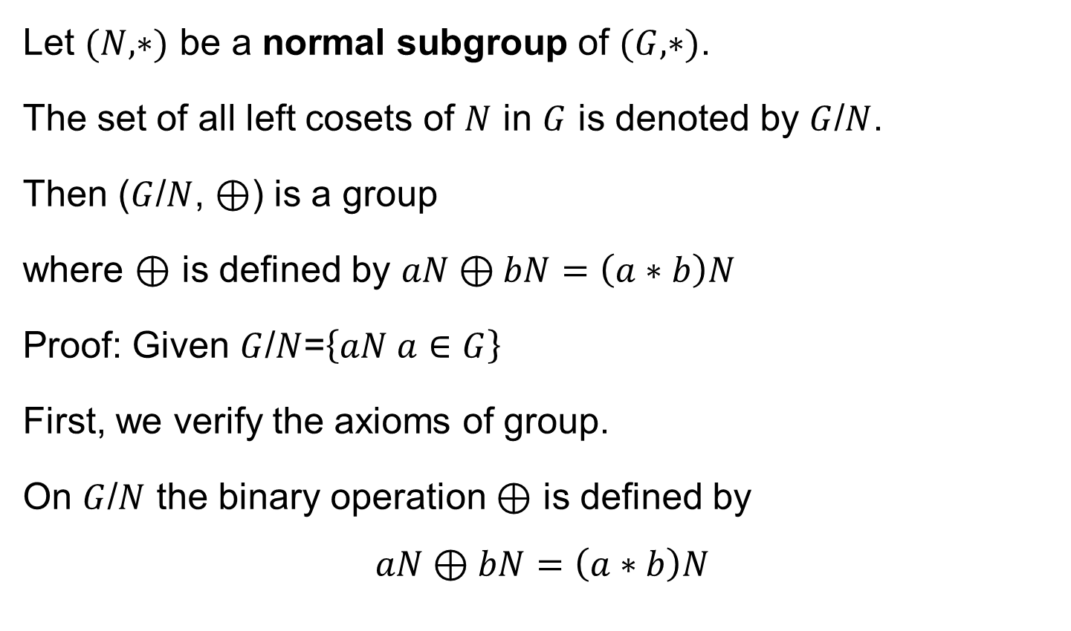
Quotient group - Theorem
Let $(N,∗)$ be a normal subgroup of $(G,∗)$.
The set of all left cosets of $N$ in $G$ is denoted by $G$/$N$.
Then ($G$/$N$, $⊕$) is a group
where $⊕$ is defined by $aN⊕bN=\left(a∗b\right)N$
Proof: Given $G$/$N$=$\left\{aN a∈G\right\}$
First, we verify the axioms of group.
On $G$/$N$ the binary operation $⊕$ is defined by
$$aN⊕bN=\left(a∗b\right)N$$

Slide 15
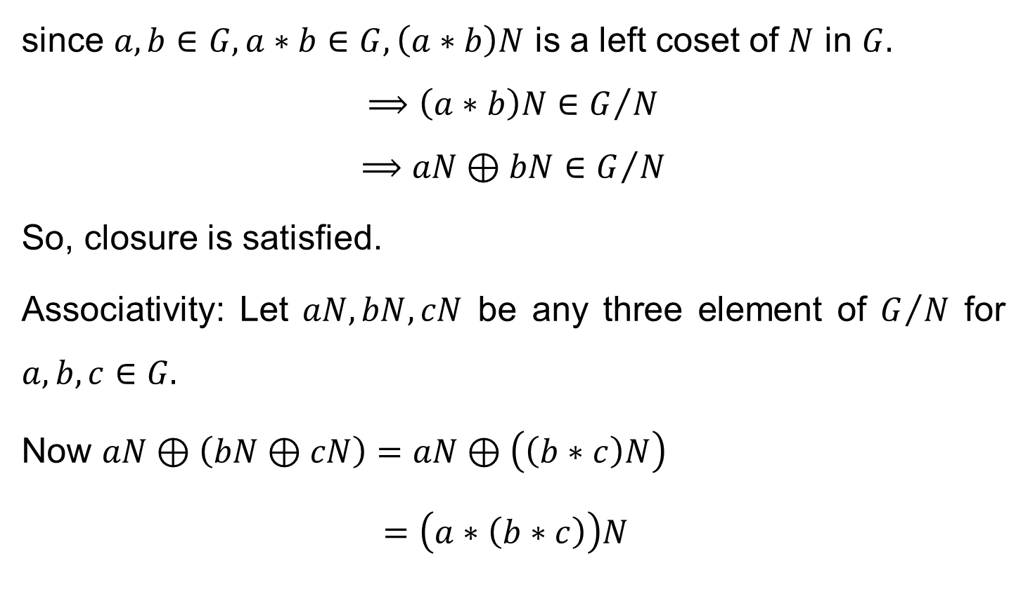
Quotient group – Theorem cont’d
since $a,b∈G, a∗b∈G, \left(a∗b\right)N$ is a left coset of $N$ in $G.$
$$⟹\left(a∗b\right)N∈G/N$$
$$⟹aN⊕bN∈G/N$$
So, closure is satisfied.
Associativity: Let $aN,bN,cN$ be any three element of $G/N$ for $a,b,c∈G.$
Now $aN⊕\left(bN⊕cN\right)=aN⊕\left(\left(b∗c\right)N\right)$
$=\left(a∗\left(b∗c\right)\right)N$

Slide 16
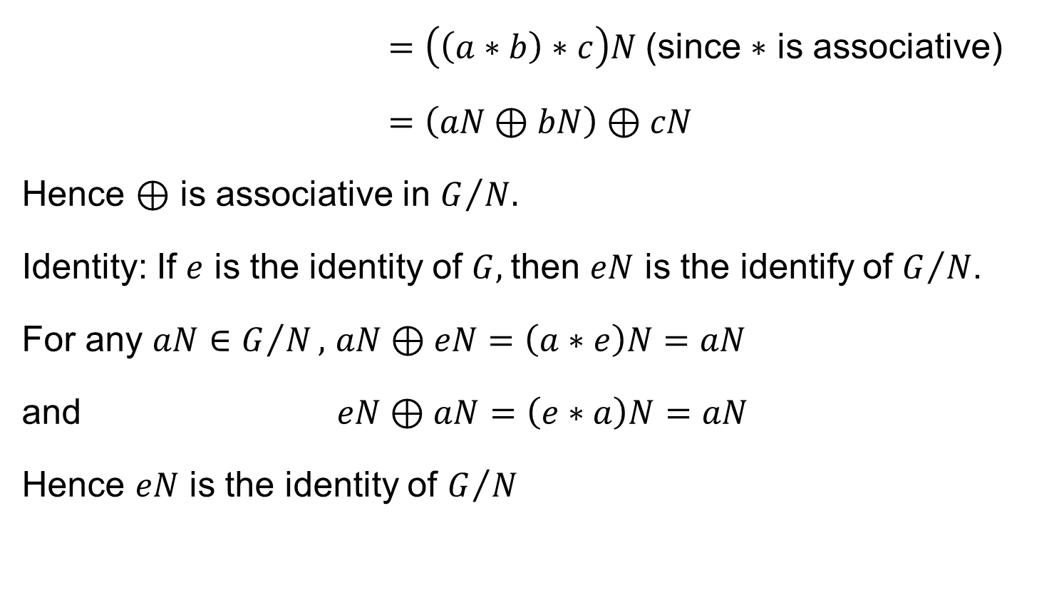
Quotient group – Theorem cont’d
$=\left(\left(a∗b\right)∗c\right)N$(since $∗$ is associative)
$=\left(aN⊕bN\right)⊕cN$
Hence $⊕$ is associative in $G/{N.}$
Identity: If $e$ is the identity of $G,$then $eN$ is the identify of $G/N$.
For any $aN∈G/N,$ $aN⊕eN=\left(a∗e\right)N=aN$
and $eN⊕aN=\left(e∗a\right)N=aN$
Hence $eN$ is the identity of $G/N$

Slide 17
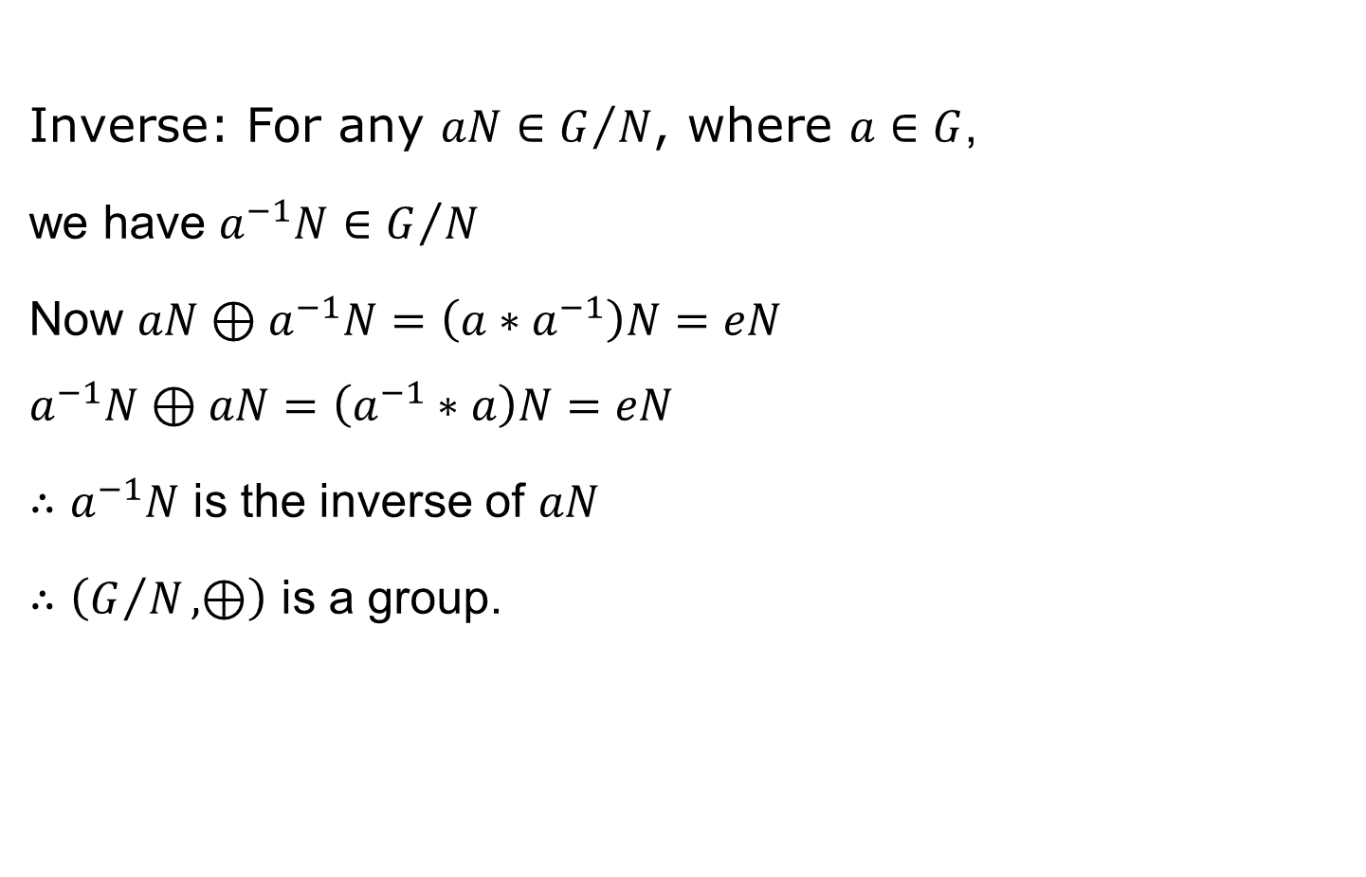
Quotient group – Theorem cont’d
Inverse: For any $aN∈G/N$, where $a∈G$,
we have $a^{−1}N∈G/N$
Now $aN⊕a^{−1}N=\left(a∗a^{−1}\right)N=eN$
$$a^{−1}N⊕aN=\left(a^{−1}∗a\right)N=eN$$
$∴a^{−1}N$ is the inverse of $aN$
$∴\left(G/N, ⊕\right)$ is a group.

Slide 18
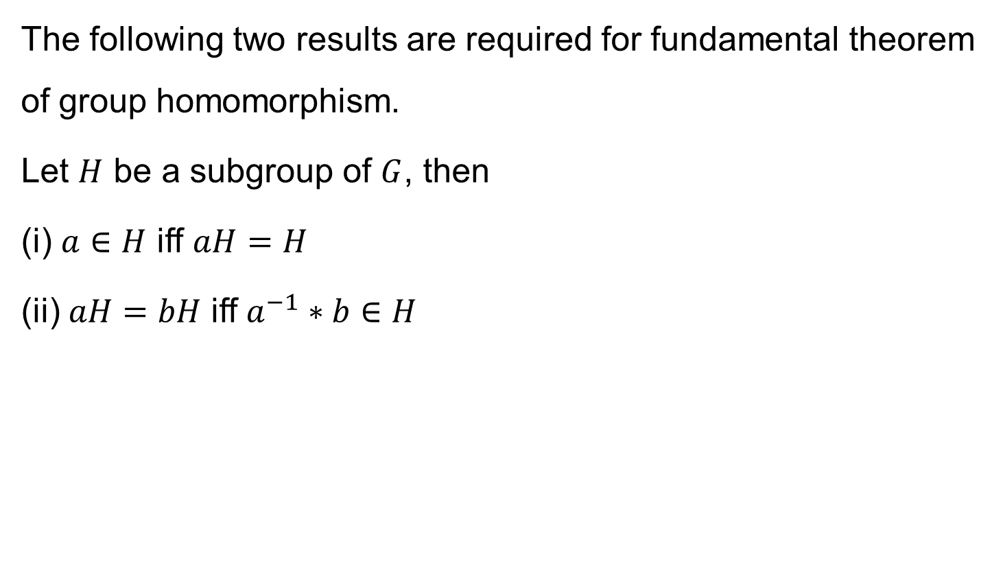
Properties of cosets
The following two results are required for fundamental theorem of group homomorphism.
Let $H$ be a subgroup of $G$, then
(i) $a∈H$ iff $aH=H$
(ii)$aH=bH$ iff $a^{−1}∗b∈H$

Slide 19

Properties of cosets cont’d
(i) To prove $a∈H$ iff $aH=H$
Proof: Let $a∈H,$ then $ah∈H$ (closure)$∀h∈H$
$$∴aH⊆H$$
If $h∈H,$ then $h=a∗a^{−1}∗h=a∗(a^{−1}∗h)$
$∴h∈aH$hence $H⊆aH$
$$∴aH=H$$

Slide 20

Properties of cosets cont’d
(ii) To prove$aH=bH$ iff $a^{−1}∗b∈H$
Proof: Assume $aH=bH$
ie. $a∗h_{1}=b∗h_{2}$
$$a^{−1}∗a∗h_{1}=a^{−1}∗b∗h_{2}$$
$$h_{1}=\left(a^{−1}∗b\right)h_{2}$$
$$∴H=\left(a^{−1}∗b\right)H$$
by previous result $\left(a^{−1}∗b\right)∈H$

Slide 21
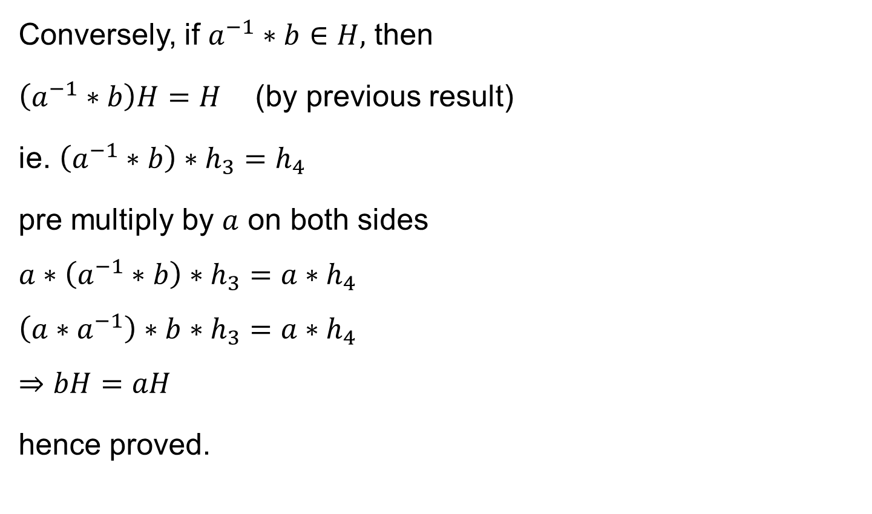
Properties of cosets cont’d
Conversely, if $a^{−1}∗b∈H,$ then
$\left(a^{−1}∗b\right)H=H$ (by previous result)
ie. $\left(a^{−1}∗b\right)∗h_{3}=h_{4}$
pre multiply by $a$ on both sides
$$a∗\left(a^{−1}∗b\right)∗h_{3}=a∗h_{4}$$
$$\left(a∗a^{−1}\right)∗b∗h_{3}=a∗h_{4}$$
$$⇒bH=aH$$
hence proved.

Slide 22
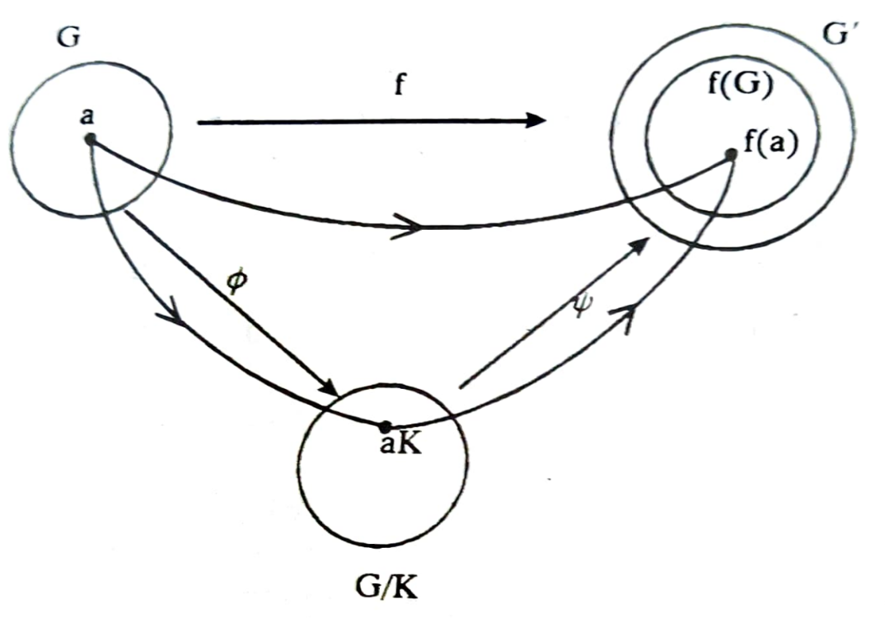
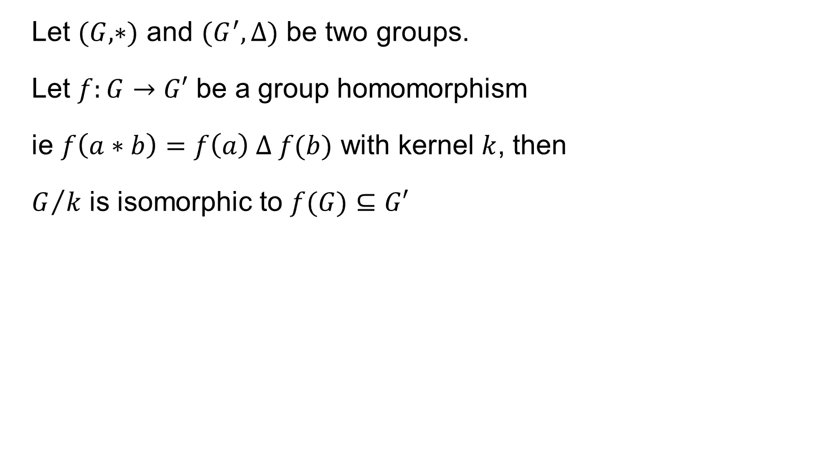
Fundamental theorem of group homomorphism
Let $(G,∗)$ and $(G^{′},∆)$ be two groups.
Let $f:G→G′$ be a group homomorphism
ie $f\left(a∗b\right)=f\left(a\right) ∆ f(b)$ with kernel $k$, then
$G/k$ is isomorphic to $f(G)⊆G′$

Slide 23
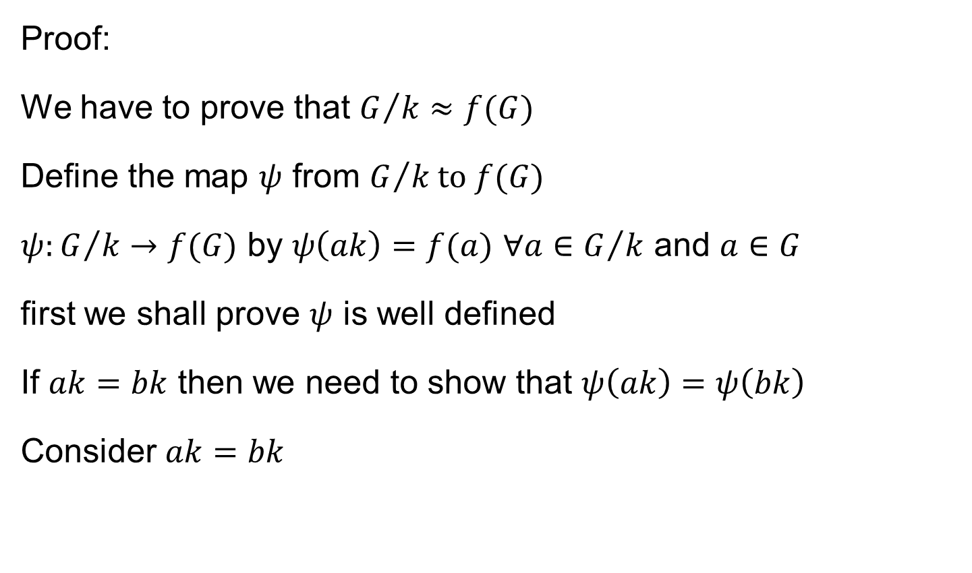
Fundamental theorem of group homomorphism
Proof:
We have to prove that $G/{k≈f(G)}$
Define the map $ψ$ from $G/{k to f(G)}$
$ψ:G/k→f(G)$ by $ψ\left(ak\right)=f(a)$ $∀a∈G/k$ and $a∈G$
first we shall prove $ψ$ is well defined
If $ak=bk$ then we need to show that $ψ\left(ak\right)=ψ\left(bk\right)$
Consider $ak=bk$

Slide 24
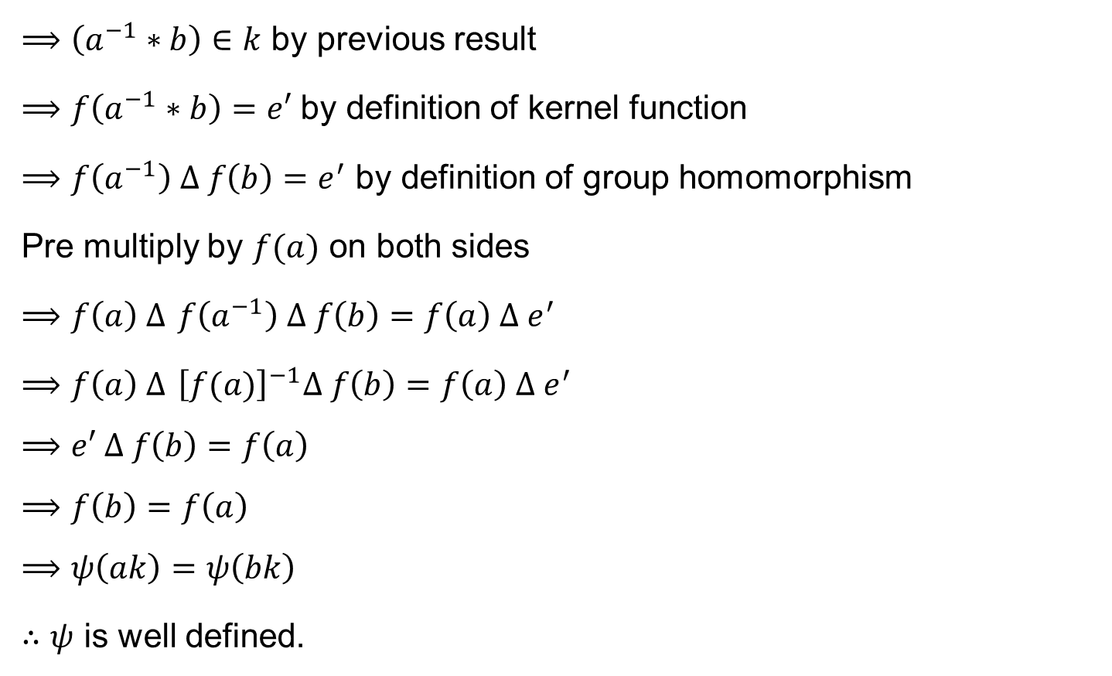
Fundamental theorem of group homomorphism
$⟹\left(a^{−1}∗b\right)∈k$ by previous result
$⟹f\left(a^{−1}∗b\right)=e′$ by definition of kernel function
$⟹f\left(a^{−1}\right) ∆ f\left(b\right)=e^{′}$ by definition of group homomorphism
Pre multiply by $f(a)$ on both sides
$⟹f\left(a\right) ∆$ $f\left(a^{−1}\right) ∆ f\left(b\right)=f\left(a\right) ∆ e^{′}$
$⟹f\left(a\right) ∆$ ${\left[f(a)\right]}^{−1}∆ f\left(b\right)=f\left(a\right) ∆ e^{′}$
$$⟹e′ ∆ f\left(b\right)=f\left(a\right)$$
$$⟹f\left(b\right)=f\left(a\right)$$
$$⟹ψ\left(ak\right)=ψ\left(bk\right)$$
$∴ψ$ is well defined.

Slide 25

Fundamental theorem of group homomorphism
Now, we need to prove that $ψ$ is a homomorphism.
Let $ak, bk∈G/k$
Now, $ψ\left(ak⊕bk\right)=ψ\left[\left(a∗b\right)k\right]$
$=f\left(a∗b\right)$
$=f\left(a\right) ∆ f(b)$
$=ψ\left(ak\right) ∆ ψ(bk)$
$ψ$ is a homomorphism of $G/k$ to $f(G)$

Slide 26

Fundamental theorem of group homomorphism
To prove $ψ$ is one - one
Suppose $ψ\left(ak\right)= ψ(bk)$
$⟹f\left(a\right)=f(b)$
Premultiply by ${\left[f(a)\right]}^{−1}$
$$⟹{\left[f\left(a\right)\right]}^{−1} ∆ f\left(a\right)={\left[f\left(a\right)\right]}^{−1} ∆ f(b)$$
$$⟹e^{′}=f\left(a^{−1}\right) ∆ f(b)$$
$$⟹e^{′}=f(a^{−1}∗b)$$
$$⟹a^{−1}∗b∈k$$
$$⟹\left(a^{−1}∗b\right)k=k$$
$$⟹a^{−1}k⊕bk=k$$

Slide 27


Fundamental theorem of group homomorphism
To prove $ψ$ is one - one
Suppose $ψ\left(ak\right)= ψ(bk)$
$⟹f\left(a\right)=f(b)$
Premultiply by ${\left[f(a)\right]}^{−1}$
$$⟹{\left[f\left(a\right)\right]}^{−1} ∆ f\left(a\right)={\left[f\left(a\right)\right]}^{−1} ∆ f(b)$$
$$⟹e^{′}=f\left(a^{−1}\right) ∆ f(b)$$
$$⟹e^{′}=f(a^{−1}∗b)$$
$$⟹a^{−1}∗b∈k$$
$$⟹\left(a^{−1}∗b\right)k=k$$
$$⟹a^{−1}k⊕bk=ek$$
Premultiply by $ak$
$${ak⊕a}^{−1}k⊕bk=ak⊕ek$$
$$\left(a∗a^{−1}\right)k⊕bk=\left(a∗e\right)k$$
$$ek⊕bk=\left(a∗e\right)k$$
$$\left(e∗b\right)k=\left(a∗e\right)k$$
$$bk=ak$$

Slide 28

Fundamental theorem of group homomorphism
To prove $ψ$ is onto
Suppose, $x∈f\left(G\right),$ then there exists an $a∈G$
Such that
$$x=f\left(a\right)=ψ(ak)$$
Thus $ψ$ is an isomorphism of
$G/k$ to $f\left(G\right).$

Slide 29
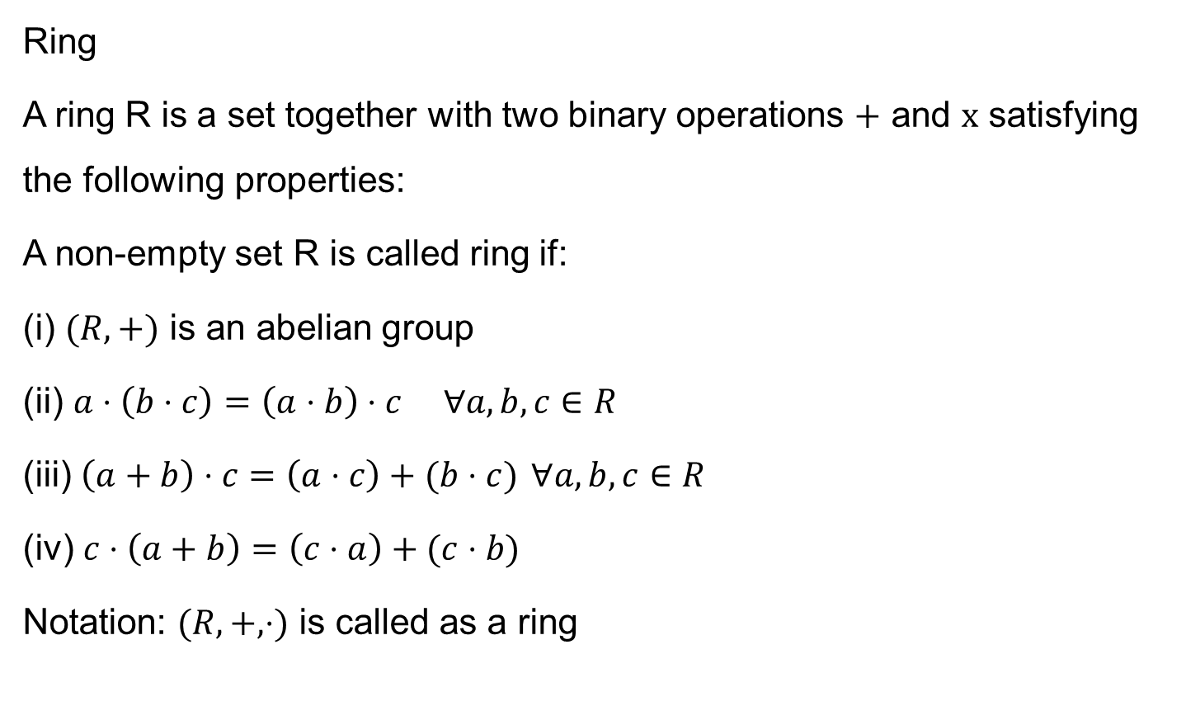
Ring and Field
Ring
A ring R is a set together with two binary operations $+$ and $x$ satisfying the following properties:
A non-empty set R is called ring if:
(i) $(R,+)$ is an abelian group
(ii) $a⋅\left(b⋅c\right)=\left(a⋅b\right)⋅c ∀a,b,c∈R$
(iii) $\left(a+b\right)⋅c=\left(a⋅c\right)+(b⋅c)$ $∀a,b,c∈R$
(iv) $c⋅\left(a+b\right)=\left(c⋅a\right)+(c⋅b)$
Notation: $(R,+,⋅)$ is called as a ring

Slide 30
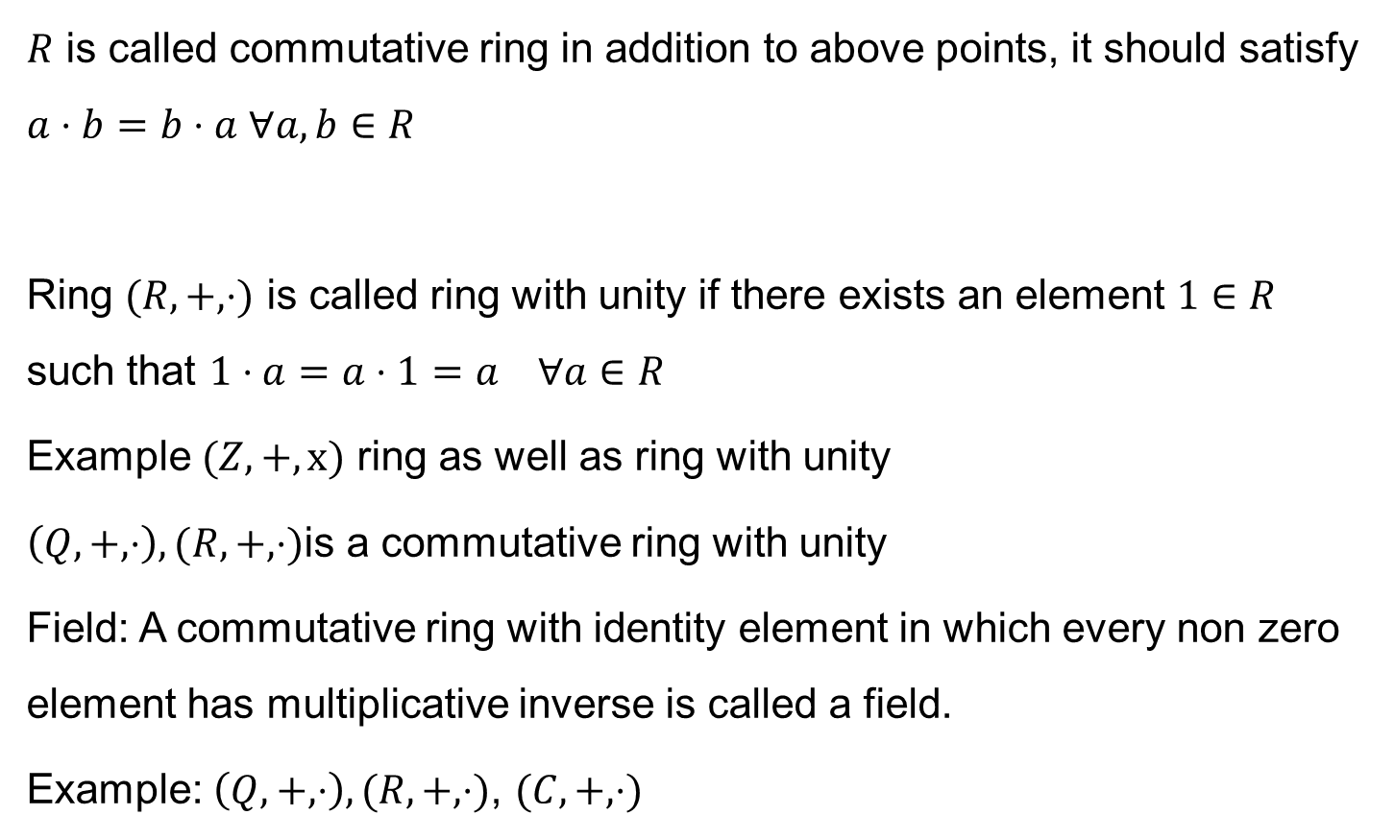
Ring and Field
$R$ is called commutative ring in addition to above points, it should satisfy $a⋅b=b⋅a ∀a, b∈R$
Ring $(R,+,⋅)$ is called ring with unity if there exists an element $1∈R$ such that $1⋅a=a⋅1=a ∀a∈R$
Example $(Z, +, x)$ ring as well as ring with unity
$\left(Q, +, ⋅\right),(R, +, ⋅)$is a commutative ring with unity
Field: A commutative ring with identity element in which every non zero element has multiplicative inverse is called a field.
Example: $\left(Q, +, ⋅\right),(R, +, ⋅)$, $(C,+,⋅)$

